Slide 1

the
workshop

Slide 2
WRITING TASK 1 – GENERAL INFORMATION
You have about 20 minutes.
You must write a report of at least 150 words.
You will be given either a line graph, a bar chart, table, a map or a process, etc.
You are required to report the main features of the graph and make comparisons where relevant.

Slide 3
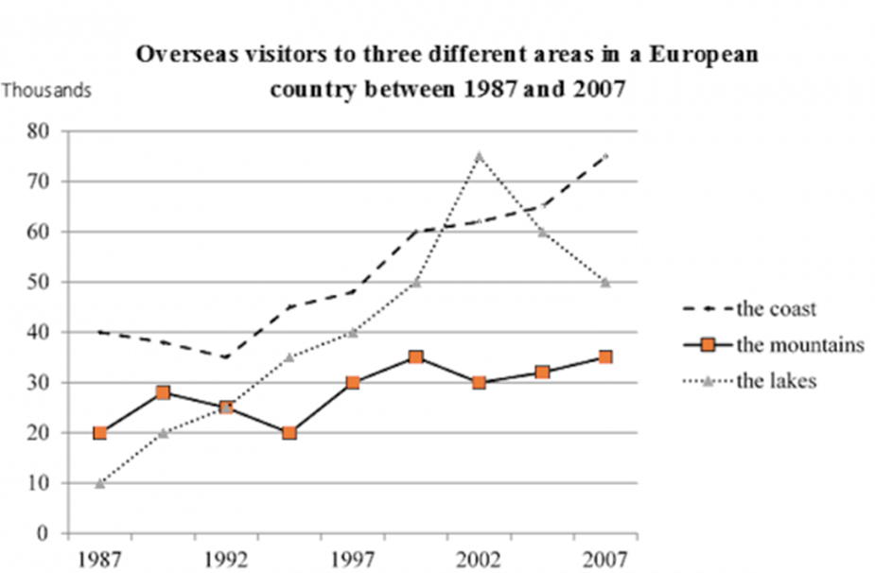
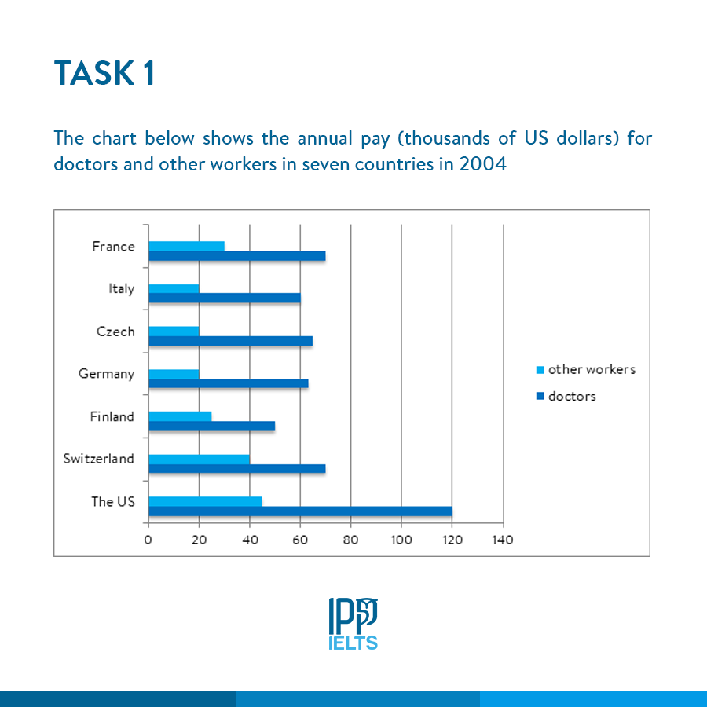
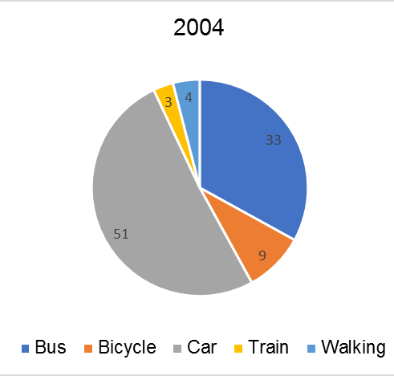
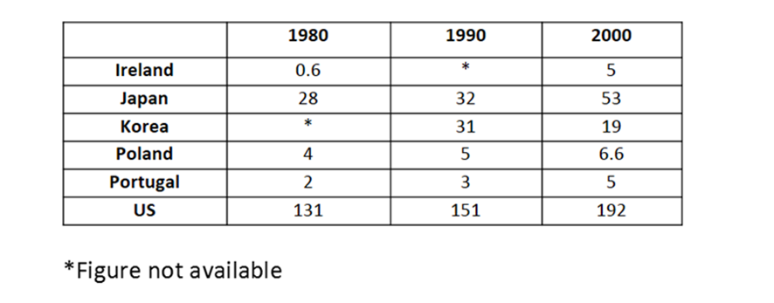

Slide 4
2 TYPES OF STATISTICAL GRAPH
DYNAMIC (TIMELINE)
=> Increase/decrease (Trend) + Ranking (Order)
STATIC (NO TIMELINE)
=> Ranking (Order)

Slide 5
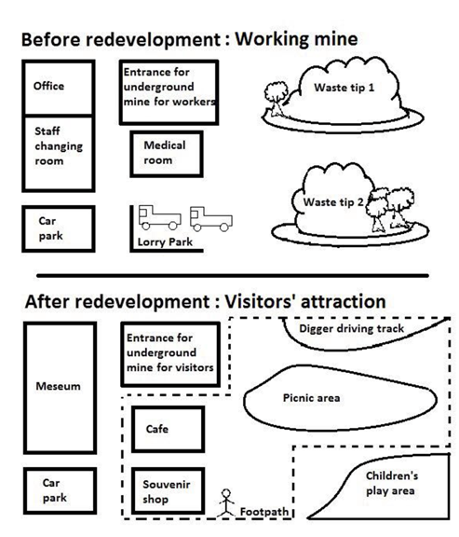
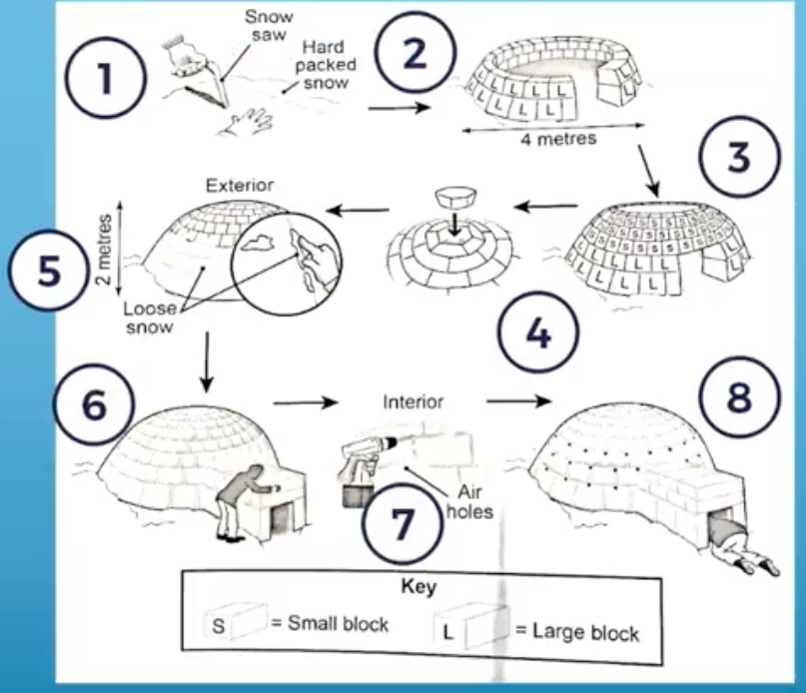
PROCESS - MAP

Slide 6
FOUR VITAL STRUCTURES
A (cái gì đó) tăng/giảm: A increase(s)/decrease(s).
Có một sự tăng/giảm trong A: There is an increase/decrease in A.
A thực hiện một sự tăng/giảm: A experience(d) | register(ed) an increase/decrease.
Thời gian nhìn thấy một sự tăng/giảm trong A: Time saw | witness(ed) an increase/decrease in A
Increase/decrease: gradable verbs.
Notes:
Từ chỉ trend, dạng từ đó -> 2 cấu trúc mấu chốt – V+adv; adj+N (để thể hiện degree) => viết ra 1 file word

Slide 7
MOVEMENT VOCABULARY - INCREASE
rise | increase | climb | grow | go up
(speed) slowly | steadily | rapidly
(degree) slightly | moderately | considerably | significantly | substantially | steeply | sharply.
a steady increase
a considerable rise
Verb + adv = there be a/an adj + Noun
(v) Jump | soar | rocket = increase rapidly and sharply (non-gradable verbs)

Slide 8
MOVEMENT VOCABULARY - DECREASE
fall | decline | decrease | drop | go down
(speed) slowly | steadily | rapidly
(degree) slightly | modestly |
considerably | significantly | substantially
| steeply | sharply
a steady decline
a considerable downturn
Verb + adv = there be a/an adj + Noun
(v) plunge | plummet = decrease sharply
and quickly (non-gradable verbs)

Slide 9
MOVEMENT VOCABULARY – VOLATILE DATA
(v) fluctuate | oscillate
violently | wildly
(n) a violent | wild
fluctuation | oscillation | volatility
(be careful when using this!)
(a) volatile – A is volatile |
has volatile data

Slide 10
MOVEMENT VOCABULARY – HIGHEST & LOWEST POINT
peak at 5 | reach a peak of 5
bottom at | hit a low of | reach a trough /trɑːf/ of 0.25

Slide 11
MOVEMENT VOCABULARY – NO CHANGES
remain relatively unchanged | constant
plateau at | reach a plateau at
stabilize at | level off | even out at

Slide 12
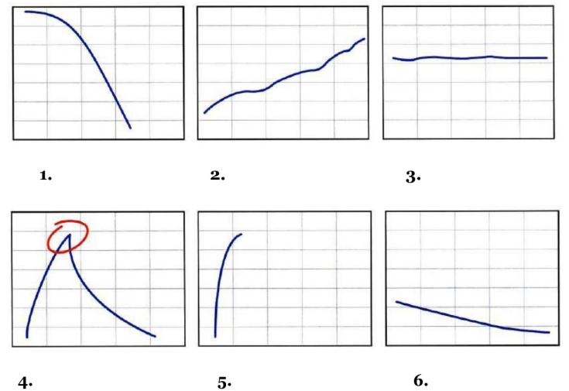
Exercise 1: use 2 expressions to describe each trend

Slide 13
WRITING VOCABULARY - DATA
Between(from) March and(to) April, the number rises considerably from 5 to 10
= Between(from) March and(to) April, there is a considerable rise of 5 in the number.
During the period of March and April, the number increases significantly by 5.
= During the period of March and April, there is a significant increase of 5 in…
Preposition: from…to… ; by; of.

Slide 14
WRITING VOCABULARY - DATA
(position)
stood at 5 = was 5
(adverbs of time)
from 2009 to 2019 = between…and
over a ten-year period starting from 2009
over a course of ten years starting from 2009

Slide 15
Exercise 2: rewrite each sentence in 3 other ways
Example:
The consumption of chocolate fell steadily from 1990 to 2000.
= There was a steady fall in the consumption of chocolate from 1990 to 2000.
= The ten-year period from 1990 to 2000 witnessed a steady fall in the
consumption of chocolate.
= The consumption of chocolate experienced a steady fall from1990 to
2000.
The development of new products fell gradually during 2000.
There has been a noticeable decrease in research investment of 50% since 1980.
The purchases of tickets dropped significantly by a half last month to 25.

